Slide 1

Database Modeling

Slide 2
What have we done so far?
We looked into the business process.
Similar to what we have done with the business game.
In a process we can find data
Based on this information we can produce information, like graphs or tables.
We worked with some datasets.

Slide 3
What are we going to do?
We will learn how to read a data model.
We will learn SQL statement to retrieve data from a database
We will continue the exploration of R as a language
Finally we will connect all the dots together

Slide 4
What will we do in the advanced
We will make a data model design
We will make the database
We will continue in SQL
And look at the combination with the tidyverse
Within a project we will make process to manage a student flat.

Slide 5
The previous test
Answers are online to review.
Make sure to review the working with data again.
The DataCamp courses are still open, we will continue with our own courses.

Slide 6


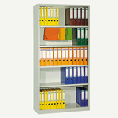
What is a database?
Notes:
A database is an organized collection of data.
Something to store information in that is of value to someone (how vague!)
Is information trackable in these archives/databases ?

Slide 7
The Characteristics of Databases
The purpose of a database is to help people track things of interest to them.
The most commonly used type of database is the relational database
Data is stored in tables, which have rows and columns like a spreadsheet. A database may have multiple tables, where each table stores data about a different thing.

Slide 8

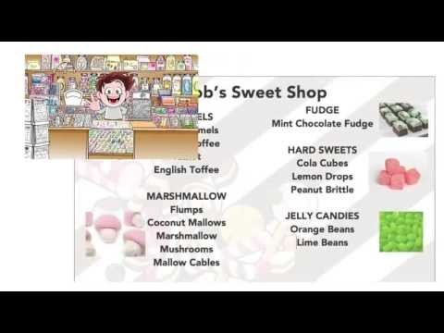
The Characteristics of Databases
A database stores data and relationships among other things…
Notes:
Video explaining records (0.00 till 3.00):
https://www.youtube.com/watch?v=t8jgX1f8kc4
Video explaining relationships:
Bob and his candy store
https://www.youtube.com/watch?v=ia4eCxPPc_o

Slide 9
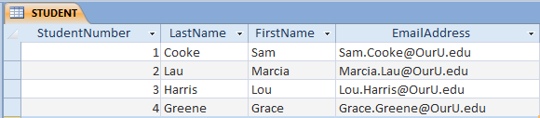
Example Table

Slide 10
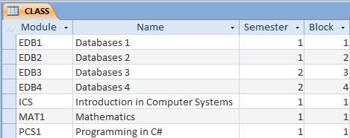
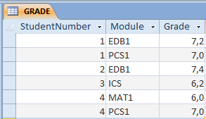
More Tables

Slide 11
Who do these grades belong to?

Slide 12
The Key Characteristic of Databases: Related Tables

Slide 13
Data versus Information
Data = recorded facts and figures
Information = knowledge derived from data
Databases store data, but they do so in such a way that we can produce information from the data.
The data on STUDENTs, CLASSes, and GRADEs could produce information about each student’s GPA.
Notes:
Voorbeeld:
9 = Data zegt ons niets
Edb1 grade = 9 = informatie: we ‘weten’ nu dat 9 het cijfer is voor een exam (voor wie??)
GPA = grade point average

Slide 14





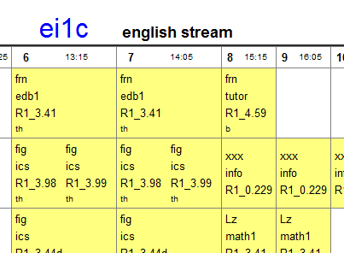




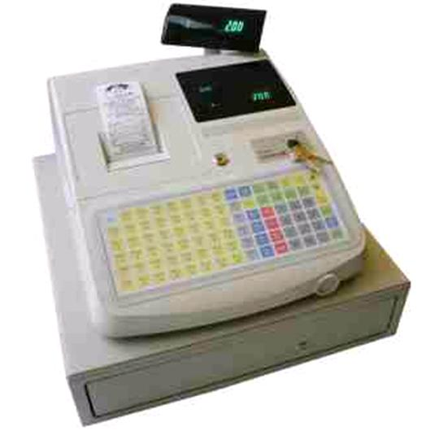
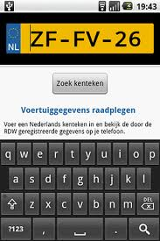
Databases in your everyday life

Slide 15
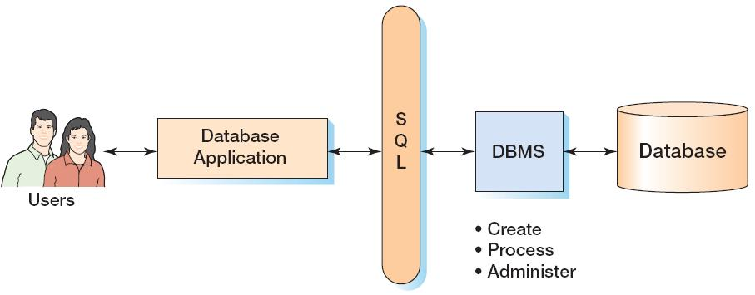
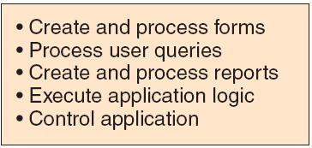
Database Applications

Slide 16
Components of a Database System

Slide 17
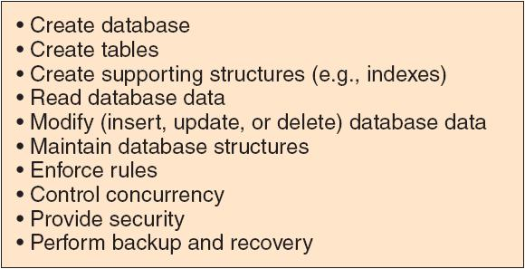
The DBMS

Slide 18
Prominent DBMS Products
Microsoft Access
Microsoft SQL Server
Oracle
MySQL
DB2

Slide 19
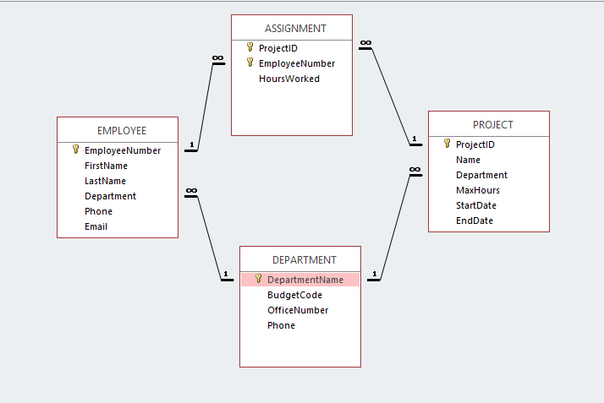
A Manual to Databases
Notes:
How does the relation between 1 to many read?
What can we see in this relational model?
An employee has assignments
A department has employees
A project has assignments
A department has projects
And have a look the other way around,
In the sense of the employee belongs to the department.

Slide 20
Items in the model
1 to many relationship
Primary Key
Foreign Key
Cardinality
More relationships

Slide 21
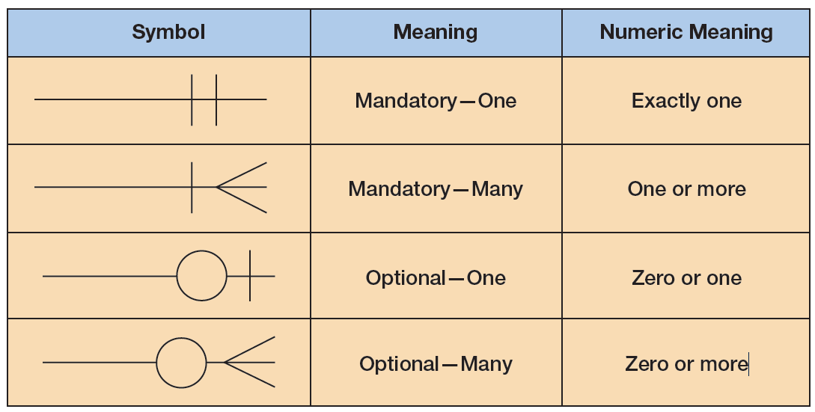
connections
Notes:
Discuss the 16 different types you can make with these 4

Slide 22
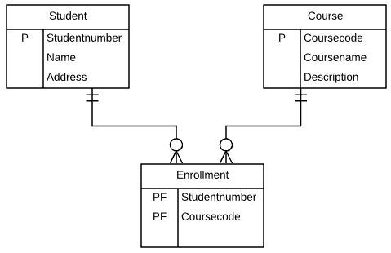
Why not many to many
Why is it not possible to have many to many relations.
How can we solve this?
Notes:
We add an intersection

Slide 23
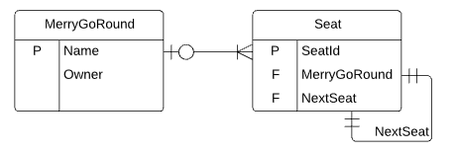
Looped
Notes:
In a merry-go-round each seat is followed by another. There is no first or last seat.

